Slide 1
Modern Control Theory
Model Predict Control - MPC – Lecture 11
Constrained Control move calculation - MIMO

Slide 2
Handling constraints
Inputs
Rate of change constraints on the input – (Δu)
Absolute constraint (u)
Output
Output limits - y
Inputs – Hard constraints – cannot be violated
Output – Soft constraints – violation allowed with some penalty

Slide 3
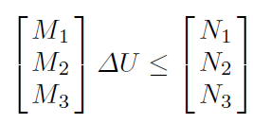







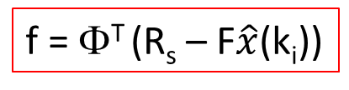
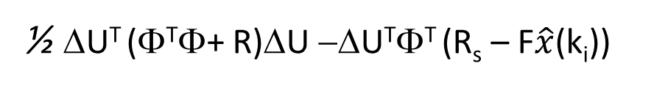
Handling constrains
Min
Δu
Min
Δu
Min
Δu
Ε = Φ^{T}Φ+ R
J/2 =
½ ΔU^{T} (Φ^{T}Φ+ R)ΔU −ΔU^{T}Φ^{T} (R_{s} – F$\hat{x}$(k_{i}))
f = Φ^{T} (R_{s} – F$\hat{x}$(k_{i}))
Min
Δu
J’= ½ ΔU^{T} EΔU + ΔU^{T} f
This is standard Quadratic programming (QP) with
E called the Hessian – symmetric positive definite
Input amplitude
Subject to
Input rate of change
Linear in constraints
Output rate of change

Slide 4
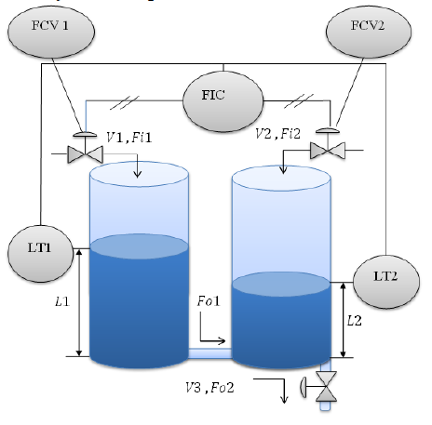






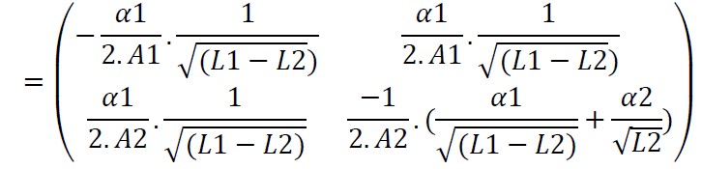

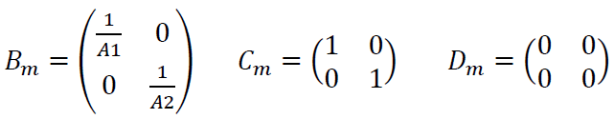
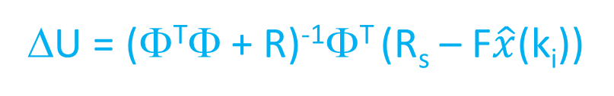
Example problem
Level control of coupled tanks
Linearize around some operating point (h1.h2), we get
A_{m}
Matrices to compute:
Φ, F, Φ^{T}Φ, Φ^{T} R_{s ,} Φ^{T} F
ΔU = (Φ^{T}Φ + R)⁻¹Φ^{T} (R_{s} – F$\hat{x}$(k_{i}))

Slide 5



Demo
Linearize around L1 = 4m, L2 = 3.5m
Sampling time = 0.05 secs, discretize
Np = 10, Nc = 3
Input constraints
Low limit – U1, U2, Δu1, Δu2
High limit – U1, U2, Δu1, Δu2

Slide 6
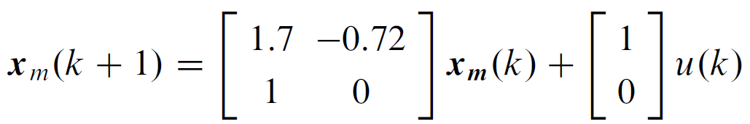
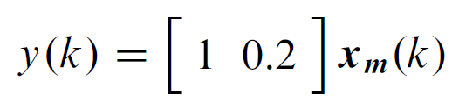
Impact of tuning – SISO system
With fixed control horizon Nc,
Increasing Np will slow down the system
With fixed prediction horizon Np,
Increasing Nc speeds the system
With fixed Np and Nc
Increasing the move weight, slows down the system
General Rule
Nc should be large enough
Np-Nc should be close to settling time of the system

Slide 7
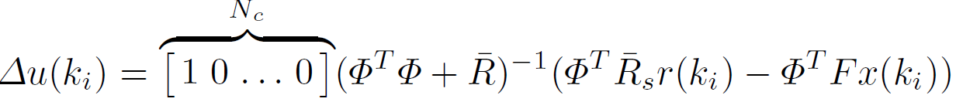



Closed loop analysis in Unconstrained MPC
Recall ΔU = (Φ^{T}Φ + R)⁻¹Φ^{T} (R_{s} – F$\hat{x}$(k_{i}))
K_{y} = First element of (Φ^{T}Φ + R)⁻¹Φ^{T} R_{s}
K_{mpc} = First element of (Φ^{T}Φ + R)⁻¹Φ^{T}F
Recall Incremental model
Closed loop Eigen Values are

Slide 8

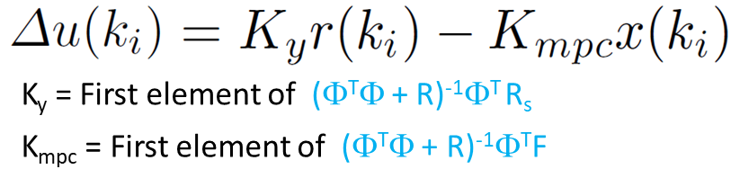





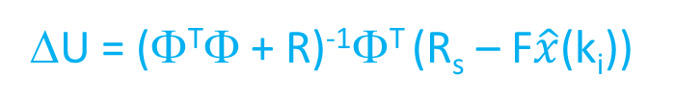
Closed loop stability example
ΔU = (Φ^{T}Φ + R)⁻¹Φ^{T} (R_{s} – F$\hat{x}$(k_{i}))
Case 1: No constraint on U R= 0
Δu = [7.2 -6.4 0 0]
Case 1: Eigen Values
Case 2: constraint on U R= 10
Δu = [0.127 0.103 0.083 0.07]
System has become slower
Case 2: Eigen Values

Slide 9
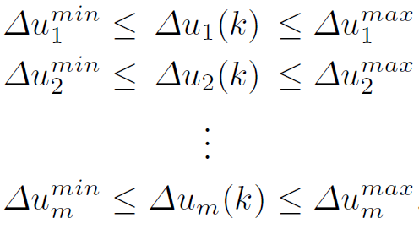
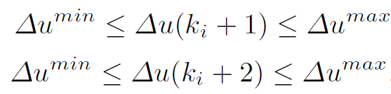


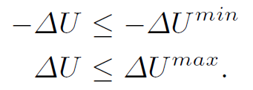
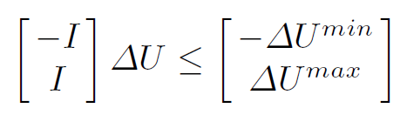

Handling input constraints - incremental change in inputs
Decision variable is Δu
Rate of input change: Most easy constraint to include

Slide 10
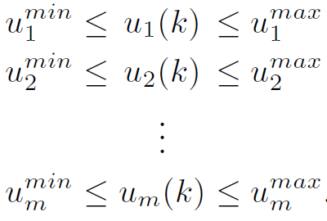




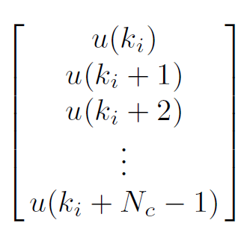
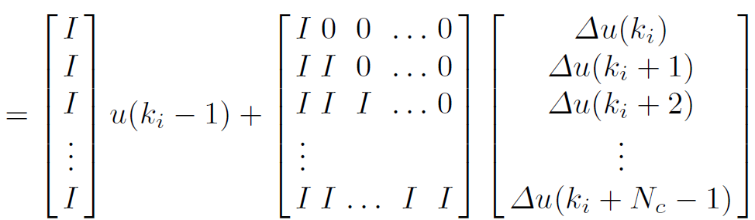





Handling input constrains – Amplitude of control signal u
Decision variable is Δu
Example: SISO Nc = 4
-
C1
C2

Slide 11

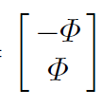
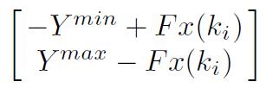


Handling output constraints – control limits
y1_{min} < y1_{pred} (k)< y1_{max}
y2_{min} < y2_{pred} (k)< y2_{max}
….
yq_{min} < yq_{pred} (k)< yq_{max}
Y_{min} < Y_{pred} (k) < Y_{max}
Y_{min} < Y_{pred} (k+1) < Y_{max}
…
Y_{min} < Y_{pred} (k+Np) < Y_{max}
Y_{pred} = Fx(k_{i}) + ΦΔU

